Slide 1
Office 365 Development

Slide 2
MODULE TITLE

Slide 3















Vision
EXTEND OFFICE EVERYWHERE
CONNECT TO OFFICE 365 SERVICES
BUILD USING AN OPEN PLATFORM
Delve
z
Users and groups
Files
Mail
Calendar
My Apps
Video Portal
Contacts
Office Graph
Presentations
Documents
Spreadsheets
Lync
OneNote
Yammer

Slide 4

Agenda
My Apps Page
App Launcher
Office 365 & OpenID Connect
Acquiring Apps from Gallery
Adding Custom Apps to App Launcher

Slide 5
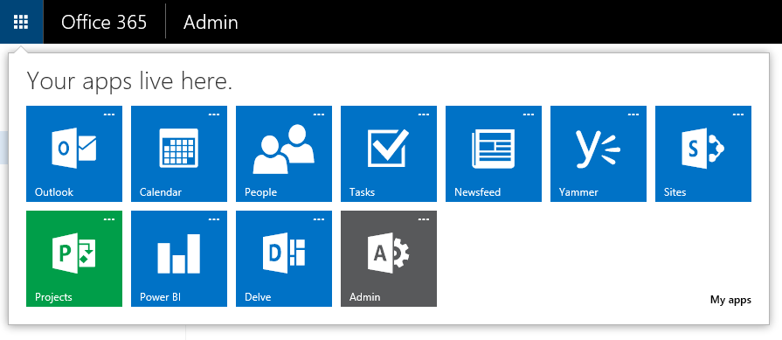
App Launcher
Easily access your apps from the nav bar
Accessible everywhere throughout Office 365

Slide 6
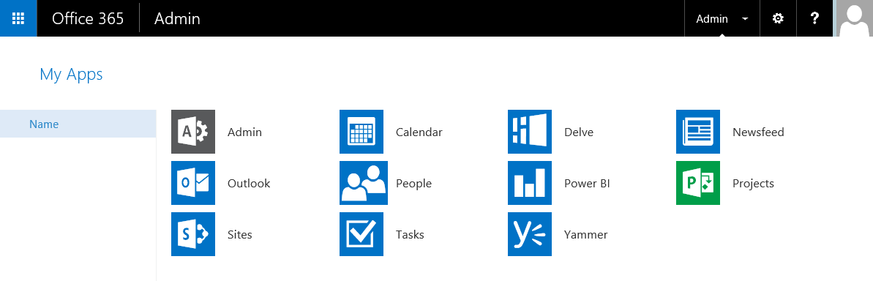
My Apps Page
My Apps page: where all your apps live
Customizable: pin and unpin applicationss
Extensible: add enterprise applications

Slide 7
App Launcher & My Apps: Make Them Yours!
Customizable: pin and unpin apps
Extensible: add enterprise apps

Slide 8
Customizing the My Apps Page & App Launcher

Slide 9
How to Extend the App Launcher
Add apps from the Azure Active Directory Gallery
Federated single sign-on
Password single sign-on
Create new applications integrated with OpenID Connect
For your organization
For other organizations
Azure Active Directory and Office 365
Every Office 365 and Azure subscription has an associated Azure Active Directory

Slide 10
Username & Password Single Sign-On

Slide 11


OpenID Connect
OpenID Connect 1.0 is a simple identity layer on top of OAuth 2.0
It enables clients to verify the identity of the user and to obtain basic profile information
Lightweight, yet very powerful

Slide 12
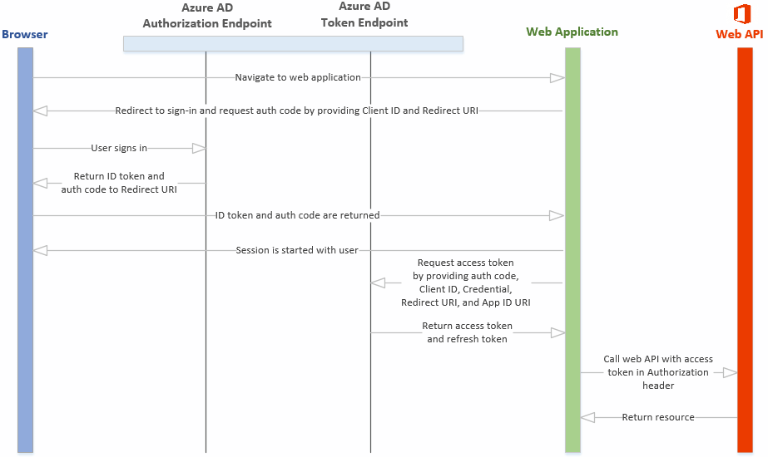
High level SSO protocol flow
1
Web sign-in using OpenID Connect
2
3
4
Office API access
5

Slide 13
OpenID Connect Based
Single Sign-On

Slide 14
Adding Custom Applications to App Launcher & My Apps Page

Slide 15
App registration in Azure AD
Tenant
Register within an AAD tenant
LOB
SaaS app
Location
Reply address, for web apps, a valid endpoint where you app is hosted
Application identifier
App ID URI for WS-FED and SAML
Client_id for OpenID Connect and OAuth
Uniqueness is enforced for SaaS app identifiers
Secret keys
A key the web app can use to authenticate to AAD
For SaaS app, same key for all tenants

Slide 16
Adding Custom Applications to App Launcher & My Apps Page

Slide 17
Summary
My Apps Page
App Launcher
Office 365 & OpenID Connect
Acquiring Apps from Gallery
Adding Custom Apps to App Launcher

Slide 18



dev.office.com
Sign up
http://dev.office.com/getting-started
Explore
http://apisandbox.msdn.microsoft.com
Get trained http://dev.office.com/training

Slide 19


Feedback
Office 365 Network Share you best practices and join conversations https://www.yammer.com/itpronetwork
Stackoverflow Ask deep technical questions to a world-wide set of developers
http://stackoverflow.com/questions/tagged/ms-office
UserVoice Provide suggestions of what you want in future versions
http://officespdev.uservoice.com/

